Slide 1
Cell Metabolism

Slide 2
Types of Respiration
Anaerobic | Aerobic
Cytoplasm | Mitochondria
Glucose to pyruvic acid to lactic acid | Pyruvic acid to CO₂ and H₂O
Produces only 2 ATP | Produces a total of 38 ATP
Does not require O₂ | Requires O₂
Also called glycolysis | Also called Kreb’s or citric acid cycle

Slide 3
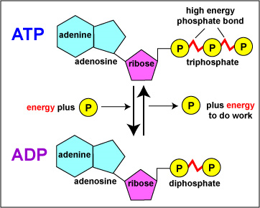
The ATP cycle

Slide 4
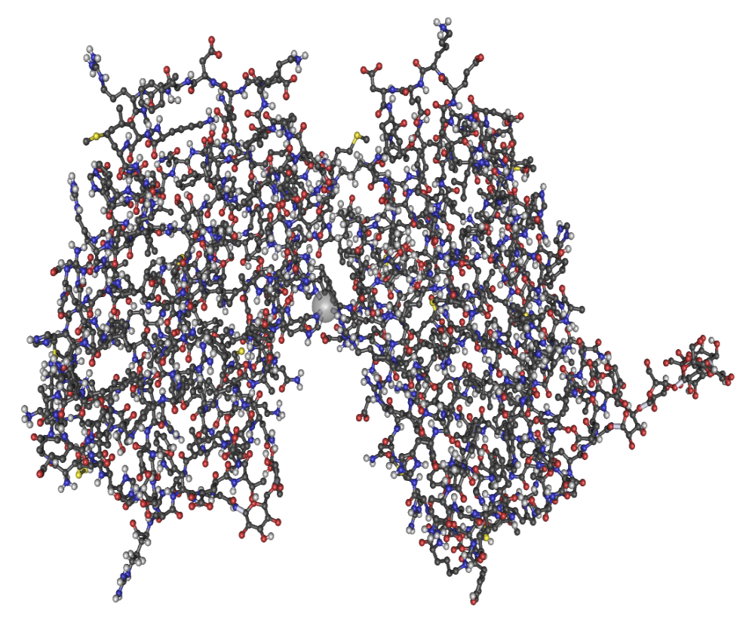
Protein synthesis
Proteins are long chains of amino acids often folded into complex 3D shapes
DNA send instructions to ribosomes to assemble proteins out of amino acids

Slide 5
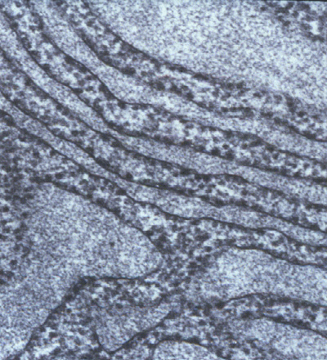
Most ribosomes line the endoplasmic reticulum (some float free in the cytoplasm)
Cytoplasm
Endoplasmic reticulum
Ribosomes

Slide 6
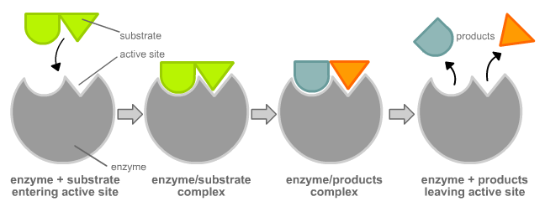
Lock and Key Model

